Slide 1
Introduction to Energy Systems
Module 5
Nuclear Energy Systems
Prepared by: Prof. Amin Ghobeity
Please do not distribute without permission

Slide 2
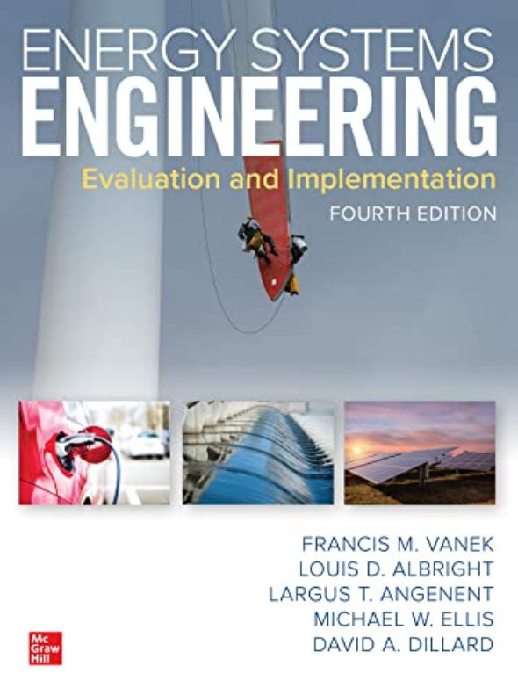
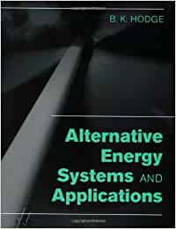
References
+ Instructor notes
Energy Systems Engineering: Evaluation and Implementation, 4th Ed.
McGraw-Hill, New York, 2021
Chapter 8 Nuclear Energy Systems
Alternative Energy Systems and Applications Paperback
By Hodge

Slide 3
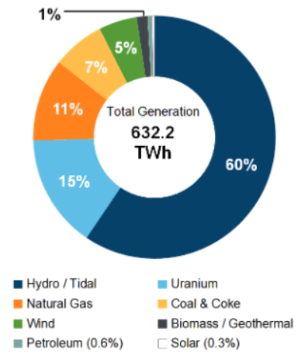
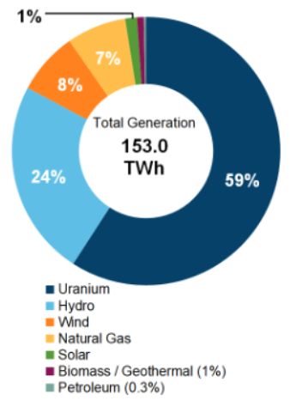
Motivation
Canada Electricity Production (2019)
Ontario Electricity Production (2019)
https://www.cer-rec.gc.ca/en/data-analysis/energy-markets/provincial-territorial-energy-profiles/provincial-territorial-energy-profiles-canada.html

Slide 4
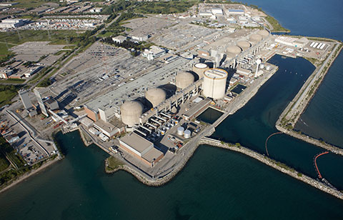
Nuclear Power Plants in Ontario
Five nuclear power plants in three provinces house 22 nuclear power reactors
All nuclear power reactors in Canada are CANDU (Canadian Deuterium-Uranium) reactors
Operating facilities in Ontario:
  Bruce Nuclear
  Pickering Nuclear
  Darlington Nuclear
Pickering Nuclear Generating Station
https://www.cnsc-ccsn.gc.ca/eng/reactors/power-plants/nuclear-facilities/pickering-nuclear-generating-station/index.cfm

Slide 5
Learning Outcome
Nuclear energy fundamentals
  The composition and stability of the nucleus.
  The relationship of the binding energy of the nucleus to its properties.
  The reactions between neutrons and nuclei.
  Fission processes in the isotopes of uranium.
  Nuclear energy released from fissioning of U-235.
  Critical reactions and thermal reactor control.
Nuclear reactor designs
  Boiling water reactor (BWR)
  Pressurized water reactor (PWR)
  Gas-cooled reactor (GCR)
Nuclear power plants
  Nuclear reactor safety and the reasons and consequences of nuclear accidents.

Slide 6
Part 1 Atomic Binding Energy

Slide 7
Nucleons
Neutron and protons are collectively referred to as nucleons and the total number of nucleons,
is referred to as the mass number.
Z: the atomic number – the number of protons in the nucleus
A: the mass number – sum of neutrons and protons in the nucleus

Slide 8
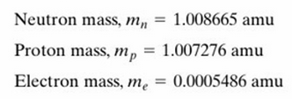
Atomic mass unit
Masses are given as masses of neutral atoms in atomic mass units (amu or simply u) where
1 amu = 1.6605402×10⁻²⁷ kg

Slide 9
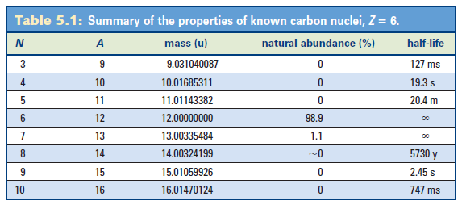
Isotopes
An element can have several isotopes all of which have the same value of Z but different values of N.
Carbon nuclei with 6 or 7 neutrons are stable.
Carbon nuclei with 3 to 6 or 7 to 10 neutrons are unstable.
Carbon nuclei with less than 3 or more than 10 neutrons are not observed.

Slide 10
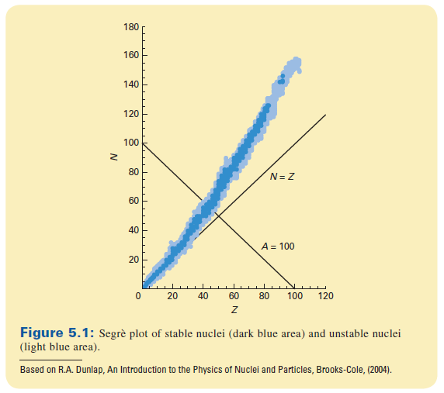
The known stable and unstable nuclides as a function of Z are shown on a Segrè plot
Light nuclei are stable with N≈Z
but heavy nuclei require N>Z to be stable.
This is a crucial feature for the operation of a nuclear reactor.

Slide 11
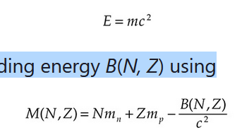
Binding Energy
The neutrons and protons in the nucleus are held together by the nuclear binding energy.
Using Einstein’s relationship between energy and mass:
we can calculate the mass of a nucleus with neutrons and protons (N, Z) and binding energy B(N, Z) using
In other words, the mass of a nucleus is the mass of the individual particles within the nucleus, minus the mass equivalent of the binding energy which holds the nucleus together. It is this binding energy which is released in order to exploit nuclear energy for useful purposes. This energy is released through various mechanisms (e.g., gamma decay)

Slide 12

Nuclear and atomic masses
The mass of a bound nucleus with N neutrons and Z protons will be
The mass of a neutral atom also includes the electron mass and the electronic binding energy, b,

Slide 13
Units in Einstein’s relation
In Einstein’s relation mass is commonly expressed in atomic mass units (u) and energy is commonly expressed in millions of electron volts (MeV).
So the speed of light squared is expressed in MeV/u with a value of
c² = 931.494 MeV/u
1 MeV = 1.602 x 10⁻¹³ J

Slide 14
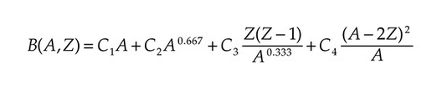
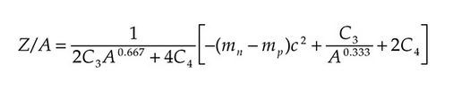
Binding Energy – Empirical Relations
From experimental observation, the following semiempirical formula for binding energy B of a nucleus as a function of A and Z has been derived:
C1 = 2.5 × 10^{–12} J, C2 = –2.6 × 10^{–12} J, C3 = –0.114 × 10^{–12} J, and C4 = –3.8 × 10^{–12} J.
The ratio Z/A that results in the lowest energy state for the binding energy of the nucleus, and hence is predicted to be the most likely value for a given value of A, can be approximated by a related, empirically derived formula:

Slide 15
Binding Energy – Summary
The binding energy of the nucleus tells us first that for light atoms, the number of neutrons and protons in the nucleus will be approximately equal, but for heavier atoms, the number of neutrons will exceed the number of protons.
Second, atoms with the strongest nuclear binding energy per nucleon occur in the middle of the periodic table, while those with the weakest binding energy occur at either the light or heavy end of the element spectrum.
Nuclei with the lowest binding energy per nucleon will be the easiest to either fuse together (nuclear fusion reactions) or break apart (nuclear fission reaction). Therefore, the elements that are most suited for use in nuclear energy are either very light or very heavy.

Slide 16


Nuclear reactions
Nuclear reactions occur when a nucleus (A) is struck by a particle (a) resulting in the production of a nucleus (B) and a particle (b)
An example of a nuclear reaction is
where the ¹⁴N nucleus captured the incident neutron and emitted one of its protons leaving a ¹⁴C nucleus behind.

Slide 17

Gamma Decay
The (n,γ) reaction results when a nucleus captures a neutron and is left in an excited state which then decays by gamma emission. e.g.
This is an important reaction for nuclear reactors.

Slide 18
Summary
The nucleus consists of neutrons and protons held together by the strong interaction
Light nuclei have approximately equal numbers of neutrons and protons
Heavy nuclei have more neutrons than protons
Unstable nuclei can decay by beta decay, alpha decay or gamma decay
Nuclear binding energy can be released during nuclear decays and nuclear reactions

Slide 19
Part 2 Nuclear Fission

Slide 20
Fission energy
Nuclear reactions can be endothermic or exothermic and either require additional energy to proceed or produce excess energy, respectively.
Reactions in which the total mass increases are endothermic and reactions where the total mass decreases are exothermic.
Changes in the mass represent changes in the nuclear binding energy.

Slide 21
Exothermic reactions
Nuclear reactions (like chemical reactions) can be
exothermic (if they give up energy) or
endothermic (if they require energy to proceed)
Exothermic reactions can be used to produce useful energy in the form of heat which can be used to generate electricity.

Slide 22
Energy per fission
²³⁸U is an example of a heavy nucleus that produces energy when undergoing fission.
²³⁸U has binding energy of about 7.57 MeV per nucleon for a total nuclear binding energy of
(238)×(7.57 MeV) = 1800 MeV
If a ²³⁸U nucleus breaks into two nuclei with 119 nucleons then each fission fragment will have about 8.50 MeV per nucleon for a total binding energy of
(238)×(8.50 MeV) = 2020 MeV
For an energy release of
(2020 MeV) - (1800 MeV) = 220 MeV per fission

Slide 23
Spontaneous fission
Spontaneous fission is a very slow process.
The probability of fission can be greatly increased by providing additional energy to the nucleus.
One convenient way of providing energy is by neutron bombardment.

Slide 24
Typical fission reactions
Fissile ²³⁵U can be used as a fission reactor fuel.
A typical fission process might be
The left over neutrons (in this case three of them) are explained by the Segrè plot - heavy nuclei require a greater N/Z ratio than lighter nuclei to be stable.
Thus when a heavy nucleus breaks into two lighter nuclei neutrons will be left over.
These neutrons are what fuel further induced fission processes and create a chain reaction.

Slide 25
Isotopes of Uranium
Uranium and Thorium are the only two naturally occurring elements that are suitable for nuclear fission.
All current nuclear reactors use uranium as a fuel.
Isotopes of uranium
²³⁵U 0.72% naturally abundant
²³⁸U 99.28% naturally abundant

Slide 26
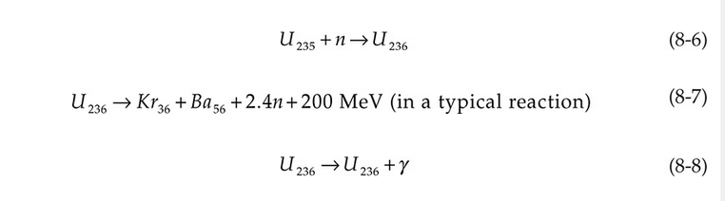
Energy Released per Fission of U-235
When a U-235 nucleus is struck by a thermal neutron, the neutron is absorbed (8-6) and then one of two reactions (8-6) or (8-7) follows:
In Eq. (8-7), the splitting of U-236 into Krypton and Barium is a representative fission reaction, though it is not the only one (as mentioned in the following slides); other products of fission are possible. Also, the exact number of neutrons released varies with the products of fission; the production of 2.4 neutrons represents the average number of neutrons released. In Eq. (8-8), the excess nuclear energy that normally drives fission of the U-236 is eliminated by radioactive decay and γ -ray emission, and the atom remains as U-236. Splitting of the U-236 nucleus into smaller nuclei [Eq. (8-7)] occurs in about 85% of cases, while in the remaining 15% of cases, the atom remains as U-236.
The fission of one atom of uranium-235 releases ~200 MeV (3.24×10⁻¹¹ J) inside the reactor.

Slide 27
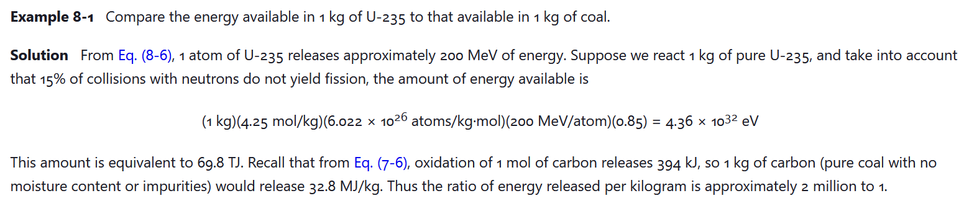
Energy Released per Fission of U-235

Slide 28

Chain Reaction of Uranium
Uranium fission in many different ways, resulting in various fission products. A general nuclear reaction for a large cohort of U-235 atoms will result in the “average” reaction:
where _{Z1}FF^{A1} and _{Z2}FF^{A2} are the fission fragments of the reaction. Examples:
The mass numbers of the fission fragments and the neutrons emitted must sum to 236. On average, 2.43 neutrons are produced. If the reaction is to be sustained, then at least one of the 2.43 neutrons must be absorbed and result in the fission of the nucleus of another U235 atom.

Slide 29
Stable chain reaction in uranium
If exactly one fission neutron goes on to induce another fission then the chain reaction will be stable (critical process).
If, on the average, less than one fission neutron induces further fissions, then the reaction will die out (subcritical process).
If, on the average, more than one fission neutron induces further fissions, then the reaction will be uncontrolled (supercritical process).
We need to ensure that the chain reaction is stable.

Slide 30
The best way to induce fission
The best way of inducing fission is to allow a neutron to be incident on a ²³⁵U nucleus at very low energy.
Neutrons are emitted with energies around
2 MeV so they need to be slowed down - this reactor design is a thermal neutron reactor.
This situation is achieved by the design of the reactor (PART 3)

Slide 31
Part 3 Nuclear Reactor Design

Slide 32
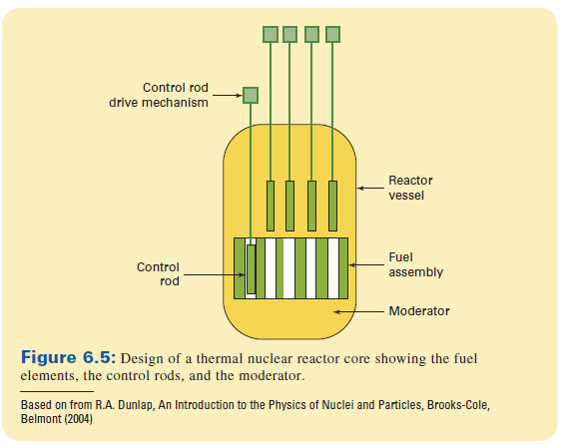
Typical fission reactor design

Slide 33
Important components of the fission reactor
1. Fuel assembly - mixture of ²³⁵U and ²³⁸U
2. Moderator - material that will slow down neutrons as they travel from one fuel element to the next
3. Control rods - material that absorbs neutrons to prevent them from reaching another fuel element

Slide 34
Fission reactor control
We need to ensure that exactly 1 neutron induces another fission in order to create a controlled chain reaction.
Fission reactions are much too fast to control by moving control rods.

Slide 35
Types of fission reactors
Different types of fission reactors differ in the material that is used for the moderator and the way in which heat is extracted from the reactor.

Slide 36
Moderator materials
An effective moderator material must
1. be fairly dense (to have a high density of nuclei for reactions)
2. be comprised of light nuclei (to maximize the energy transfer during collisions with neutrons)
3. not absorb neutrons but merely slow them down
4. not produce hazardous materials during reactions with neutrons
5. be relatively nontoxic, inexpensive and chemically stable

Slide 37
Acceptable moderator materials
Commercial power reactors use one of three moderator materials
H₂O (light water)
D₂O (heavy water)
Graphite

Slide 38
Heat transport methods
Heat may be transported out of the reactor to operate turbines using the following methods
Boiling water reactor - where the water which cools the reactor boils to produce stem to drive the turbine
Pressurized water reactor - where the water used to cool the reactor is kept under pressure and transfers its heat to water which boils by means of a heat exchanger
Gas cooled reactors - where a gas is used to cool the reactor and transfers heat to water through a heat exchanger

Slide 39
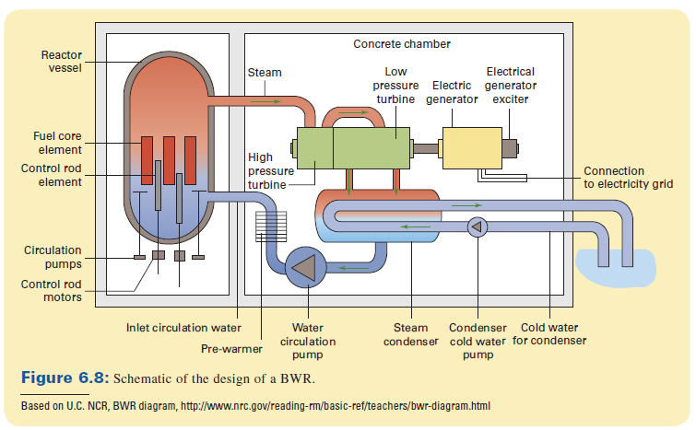
Schematic of a boiling water reactor
Water is used as both the moderator and the coolant

Slide 40
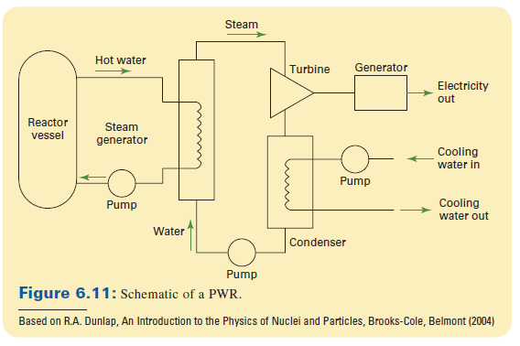
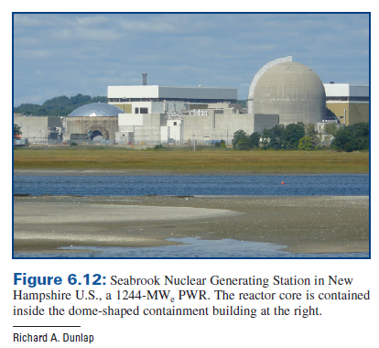
Schematic of a pressurized water reactor
The moderator and coolant may be either light (H₂O) or heavy water (D₂O)

Slide 41
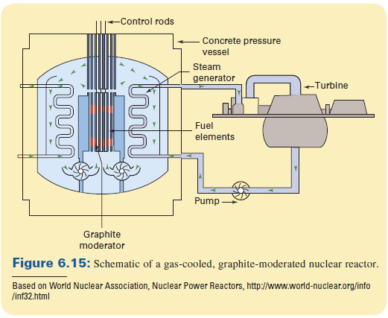
Gas (He) cooled graphite moderated reactor

Slide 42
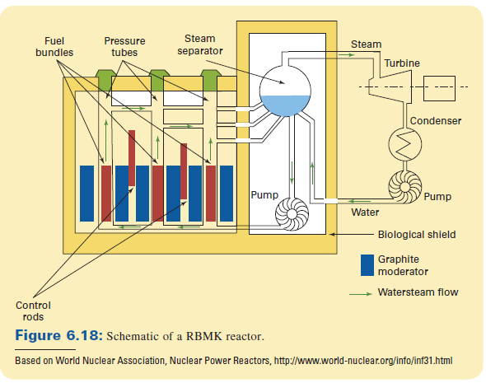
Water cooled graphite moderated reactor

Slide 43
Nuclear safety
Three notable nuclear accidents have occurred at commercial power reactors
Three Mile Island
Chernobyl
Fukushima

Slide 44
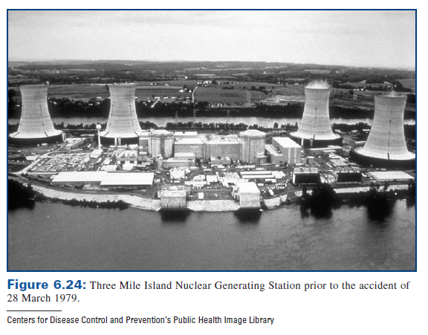
Three Mile Island (Pennsylvania)
March 28, 1979
Failure of a relief valve and water pump caused the reactor to overheat.
A small amount of radioactive material released to the atmosphere.
No immediate adverse health effects.
No anticipated long term health effects.

Slide 45
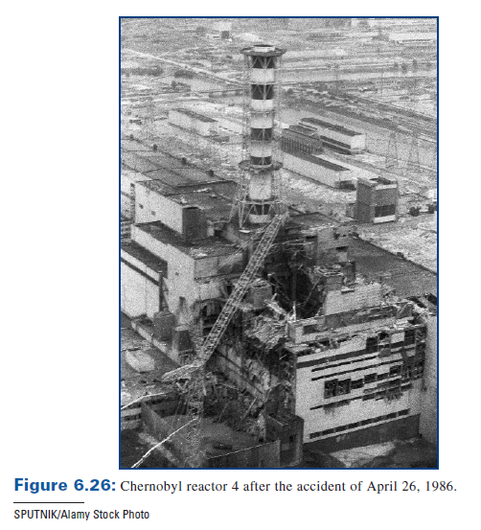
Chernobyl (Ukraine)
In Soviet Union (now part of the Ukraine)
Water-cooled graphite-moderated reactor
Typical Russian design (RBMK)
Began April 25, 1986
Reactor became unstable as a result of some operator tests.
Overheating of reactor caused water to decompose, releasing hydrogen which exploded.

Slide 46
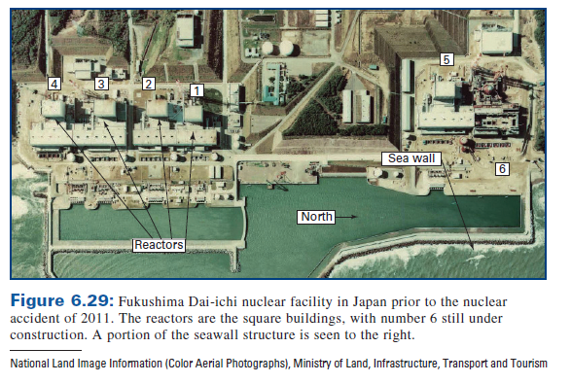
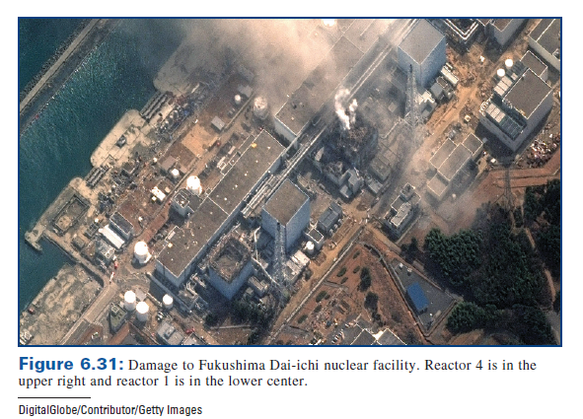
Fukushima Dai-ichi (Japan)
Facility consisting of six BWRs
Accident on March 11, 2011
Electrical infrastructure damaged by tsunami caused by off-shore earthquake
Loss of coolant caused reactors to overheat leading to explosions
Estimated release of radioactive material about 10 - 20% that of Chernobyl
Long term health effects yet to be determined

